Slide 1
From Mantra
to
Silence
Mantras and techniques to enlighten the
subtle system and bring mental silence for meditation

Slide 2
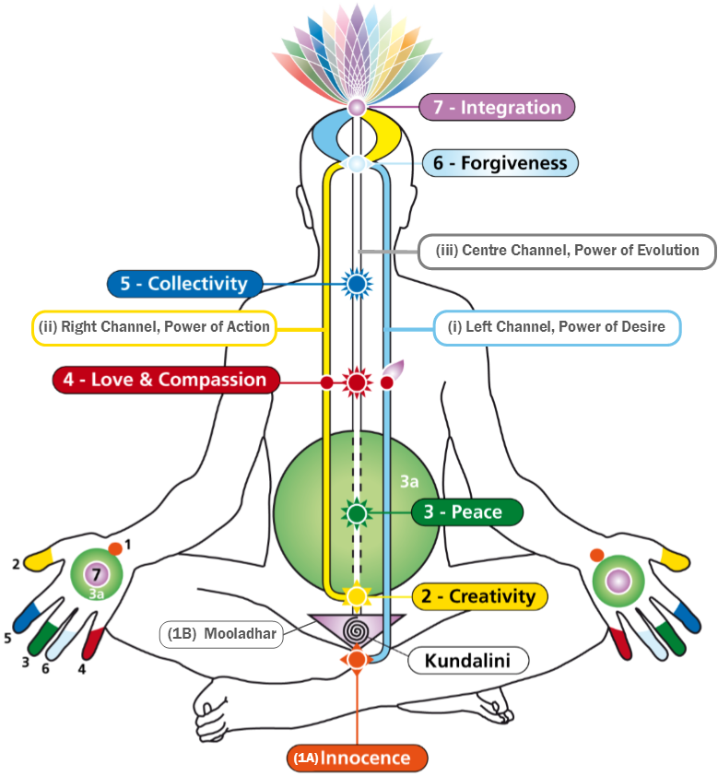

Slide 3
Om Twameva sakshat ......................... sakshat,
Shri Adi Shakti Mataji,
Shri Nirmala Devi Namoh, Namah

Slide 4
Affirmations

Slide 5
 | Chakra | Centre | Left | Right
 |  | Mother, Kundalini or Shri Mataji, Please make me… | Mother, Kundalini or Shri Mataji, I am… | Mother, Kundalini or Shri Mataji, `
1A | Mooladhara | …the innocence …the wisdom | ...the powerful innocence of a child | ...killer of devils
2 | Swadisthan | ...the creative knowledge | …true/pure knowledge of the Divine, which acts | ...doer and enjoyer
3 | Nabhi | ...a satisfied person | ...completely satisfied ...peace ...a generous person | ...royal dignity in me ...solution to all my family and money worries
3A | VOID | ...my own guru/master | ...my own guru/master | ...guru and master
4 | Heart | … a fearless person. | ...the Spirit ...forgiven for any mistakes against my Spirit | ...responsibility in me ...boundaries of good conduct in me
5 | Vishuddhi | ...a detached witness ...a part and parcel of the whole | ...not guilty | ...sweet countenance of all my words and deeds
6 | Agnya | ...a forgiving person | ...forgiven | ...forgiveness and I forgive everyone
7 | Sahasrara | ...completely Self Realised. …fully recognise the Divine. Thank You for my Self Realisation. | ...protected from all the challenges to my ascent …a realised soul. | ...victory over all the challenges to my ascent …who removes all my doubts.
The Channels
i | Left Channel | Mother, Please take away all my negative conditioning and desires.
ii | Right Channel | Mother/Divine, You do everything, I do nothing.
iii | Centre Channel | Mother, Please establish my Self Realisation.

Slide 6
Mantras

Slide 7
Om Twameva sakshat ................ sakshat,
Shri Adi Shakti Mataji,
Shri Nirmala Devi Namoh, Namah.

Slide 8
Om Twameva sakshat ....(insert Deity’s Name)..... sakshat,
Shri Adi Shakti Mataji,
Shri Nirmala Devi Namoh, Namah.
CHAKRA DEITY’S NAME
Mooladhara: Shri Ganesha
Centre Swadhisthan: Shri Saraswati, Brahmadeva
Left Swadhisthan: Shri Nirmala Vidya
Right Swadhisthan: Shri Nirmala Chitta or Himalaya
Centre Nabhi: Shri Lakshmi Vishnu
Left Nabhi: Shri Gruha Lakshmi
Right Nabhi: Shri Shesha Lakshmana
Void: Shri Adi Guru Dattatreya
Centre Heart: Shri Jagadambe Durga Mata
Left Heart: Shri Shiva Parvati
Right Heart: Shri Sita Rama
CHAKRA DEITY’S NAME
Centre Vishuddhi: Shri Radha Krishna
Left Vishuddhi: Shri Vishnumaya
Right Vishuddhi: Shri Yeshoda Mata
Agnya: Shri Mary Jesus
Left Agnya: Shri Mahavira
Right Agnya: Shri Buddha
Back Agnya: Shri Maha Ganesha
Sahasrara: Shri Kalki
Left side Shri Mahakali
Right side Shri Mahasaraswati
Central channel Shri Mahalakshmi

Slide 9
The Maha Mantra (Great Mantra)
Om twameva sakshat Shri Mahalakshmi, Mahasaraswati, Mahakali, Trigunatmitka, Kundalini, sakshat Shri Adi Shakti Mataji, Shri Nirmala Devi, Namoh, Namah.
Om twameva sakshat Shri Kalki, sakshat, Shri Adi Shakti Mataji, Shri Nirmala Devi, Namoh, Namah.
Om twameva sakshat Shri Kalki, sakshat Shri Sahasrara Swamini, Moksha Pradayini, Mataji Shri Nirmala Devyai, Namoh, Namah.

